Slide 1

Git
Version Control System
Martin Krištien

Slide 2
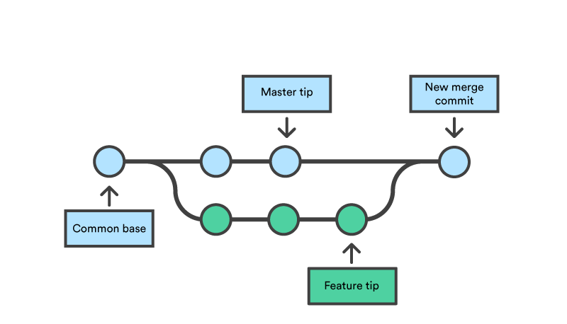
Git branch
http://git-school.github.io/visualizing-git

Slide 3
Activity #4 – git branch
Create a custom branch
Checkout the branch
Delete a file created last time
Commit the new change
Merge the branch into the “main” branch

Slide 4
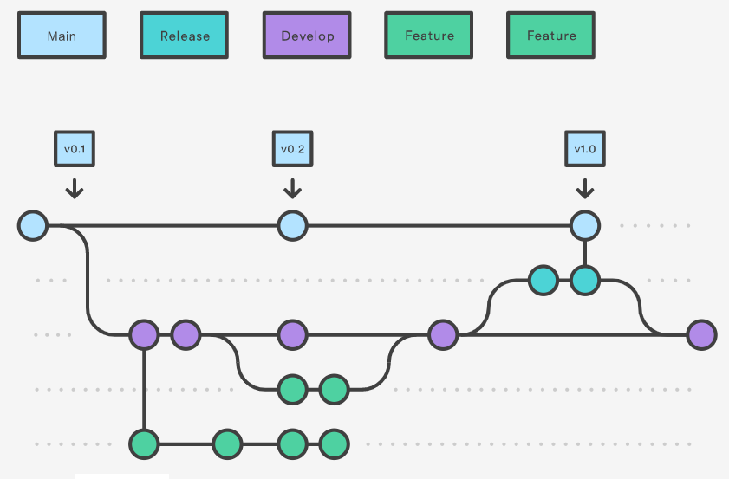
Best Practices
- Git Flow

Slide 5
Create a new branch
Add and commit a “hello_world” file
Push the commit to a remote branch
Go to github and create a Pull Request
Find another PR and do a code review
Activity #5 – Pull Request

Slide 6
Create commits regularly (at least once a day)
Independent functionality should be developed using branches
Be careful which branch is checked out when committing
Pull-request
Smaller PRs are easier to code review
Use PR description as project documentation
Best Practices

Slide 7
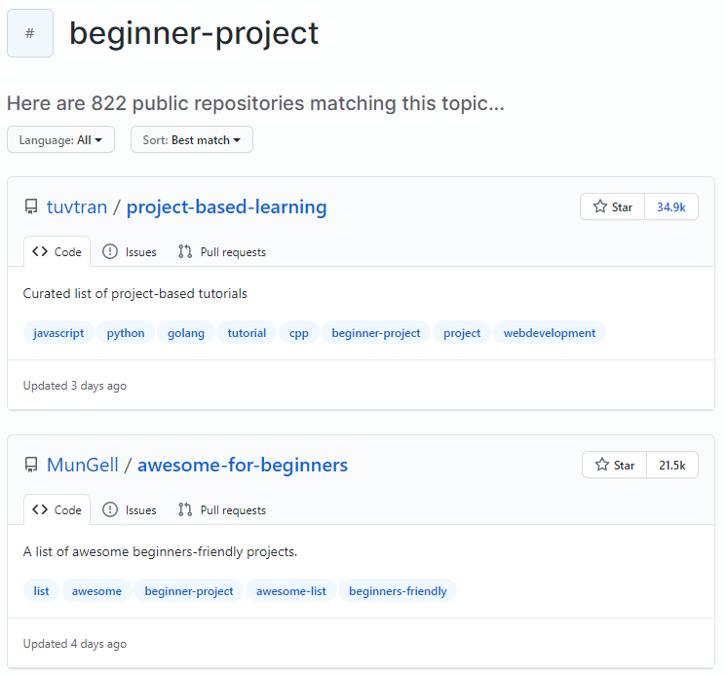
Git summed up?
Code sharing
Flexible and efficient division of code development
Easy comparison of code changes
Easy checkout of various code versions
Code backup
Code change authorship
Open-source projects

Slide 8
Additional Resources
Interactive visualisation of various git functions
https://learngitbranching.js.org/
Similar tutorials
https://www.tutorialspoint.com/git/index.htm
https://www.codecademy.com/learn/learn-git
Quick reference for git functions (cheat-sheet)
https://www.atlassian.com/git/tutorials/atlassian-git-cheatsheet
More advanced concepts
https://www.atlassian.com/git/tutorials/advanced-overview
https://www.toptal.com/software/trunk-based-development-git-flow

